Slide 1
Aim 1. Determine the ecological, phylogenetic, and network properties of root microbiomes that promote seedling performance
Exp. 1. Field survey of microbes in roots/soil of seedlings that established in post-wildfire soils
Data: Microbial community characterization (ITS, 16S, metagenomics); plant performance; environmental variables (?)
Outcome: Identify characteristics of microbiome that improve seedling performance post-wildfire
Exp. 2. Common garden exp in outdoor nursery using inocula collected across a range of environmental conditions
Data: Microbial community characterization (ITS, 16S, metagenomics); plant performance
Outcome: Identify characteristics of microbiome associated with varying seedling performance
Aim 2: Determine how microbial transplants impact root microbiome community development and seedling performance in post-wildfire soils
Exp. 3 Large outdoor field exp in post-wildfire soil with reps of all successful treatments from nursery (~10,000 seedlings, 100 inocula treatments + controls)
Field conditions: Collect data on soil moisture (continuous variable)
Data: Plant performance over time, root microbiomes (ITS, 16S) at end of exp (microbiome community development on roots on a subset of interesting seedlings at end of exp), recipient soil will be archived and samples of interest sequenced
Analysis: Effect of inocula from different source categories on seedling performance in post-wildfire soil; will also have recipient microbiome data
Outcome: Large outplanting exp gets at whether seedling performance in different inocula treatments is consistent between nursery and field conditions (e.g, strong & consistent effect of microbiome, or modulated by variable conditions in the field?)
**Too large to do soil chemistry under each seedling
Exp. 4. Priority effects exp in post-wildfire soil (pre-inoc, inoc at planting, dead inoc)
Field conditions: common garden in post-wildfire soil (smaller, more focused than giant Exp. 3)
Donor inocula: Take subset of seedling performance data based on performance in nursery (pre-inoc), pair with dried inocula from same treatments applied to roots at planting, and dead inocula of same treatment applied to roots at planting (gets at priority effects of pre-inoc before planting)
Resident microbiomes: Collect recipient soils at the time of planting (ITS, 16S, metagenomes), Soil properties (texture, pH, OM), nutrients (N), moisture availability
Data: Plant performance over time (initial data, height, lf #, health at different time points), microbiome of donor inocula, microbiome of resident soil community at planting, root microbiomes at end of exp
Outcome: Tease apart what is driving root microbiome community development in post-wildfire soils, does pre-inoc affect root microbiome over time? What about larger plant size from benefits of pre-inoc in the nursery? Priming effects? Phylogenetic or functional novelty? Etc.

Slide 2
Abiotic Conditions
Biotic Interactions
Host Performance
Guild abundance
Environmental conditions (moisture, pH, OM, nutrients)
Functional diversity
Aim 1
Microbial traits
Network connectivity
Knowledge gaps:
What affect do microbial transplants have on root microbiome assembly and plant performance?
How is root microbiome assembly and plant performance mediated by microbial source? Priority effects? Resident soil microbiomes? Environmental conditions?
Are microbial transplants an effective restoration strategy in forests post-wildfire?
Root microbiome
Aim 2
Source
Priority effects
Resident soil biota
Microbial Transplants
Understanding the role of microbial transplants on plant performance and microbiome community development after disturbance represents a critical research priority for ecological restoration

Slide 3
Potential Inocula categories
More stressful environments
Rhizosphere soils of conspecific seedlings that survived after planting in post-wildfire soils (YCP)
Thrice burned soils
Soils with low moisture availability
Less stressful environments
Once burned soils
Unburned soils
Soils with higher moisture availability
Could also sample from high-intensity vs low intensity burns; time since burn, etc.
Exp. 1. Field survey (YCP)
Focuses on aspects of microbiome associated with seedling vitality in post-wildfire soils (natural system)
Data: Plant performance, root & soil microbiomes (ITS, 16S, metagenomics)
Exp 2. Plant performance exp (outdoor nursery)
Focuses on attributes of microbiome associated with plant performance (controlled nursery conditions, lots of different sources of inocula)
Data: Plant performance (all plants, all treatments), initial inocula & root microbiomes (ITS, 16S)
Exp 2 provides source material for Exp. 3 & 4
Exp. 4 Priority effects exp in post-wildfire soil
(pre-inoc, inoc at planting, dead inoc)
Take subset of seedlings selected based on performance data in nursery (pre-inoc), pair with dried inocula from same treatments applied at planting, and dead inocula of same treatment applied at planting
Collect recipient soils at the time of planting
Resident microbiomes
Soil properties, nutrients
Data: Plant performance over time, resident soil microbiomes at planting, root microbiomes (ITS, 16S) at end of exp
Much smaller exp. than Exp. 3
Exp. 3 Plant performance field exp in post-wildfire soil
(reps of all successful treatments from nursery outplanted)
Focuses on attributes of microbiome associated with plant performance in post-wildfire soils under field conditions
Data: soil moisture availability, resident soil microbiomes, plant performance over time, root microbiomes (ITS, 16S) at end of exp (microbiome community development on roots)
Analysis: Inocula from different source categories

Slide 4
Research questions
Aim 1. Determine the ecological, phylogenetic, and network properties of root microbiomes that promote seedling performance
Question: What characteristics of the root microbiome promote seedling performance?
Hypotheses
H1: Guild abundance hypothesis: Seedling performance will be enhanced when root microbiomes have a greater proportion of microbial mutualists (e.g., ectomycorrhizal fungi) relative to saprotrophs, endophytes, or pathogens
H2: Microbial trait hypothesis: Seedling performance will be enhanced in root microbiomes that are enriched in taxa that confer tolerance to stress (e.g., Dove et al. 2022)
H3: Functional diversity: Seedling performance will be enhanced in root microbiomes comprised of taxa that represent high functional diversity
H4: Network connectivity: Seedling performance will be enhanced when root microbiomes contain taxa with high co-occurrence network connectivity
Approach:
Exp. 1: Post-fire seedling microbiomes in the field: Collect soil cores from root zone of surviving Doug fir seedlings for sequencing (focus on roots if we can get them), plant growth/health data, environmental data? (e.g., % OM, moisture availability, pH); Illumina sequencing (ITS, 16S), Metagenomics (functional component e.g., CAZy genes, N cycle genes), viruses, oomycetes, etc.) – this is in post-wildfire soil
Exp. 2. Microbiome screen on nursery seedlings (WSUV) - Collect soil inocula from a broad range of field conditions to use in a nursery inoculation (common garden) experiment to home in on what aspects of the soil microbiome are associated with improved conifer seedling performance (under controlled conditions) – this is in sterile background soil in the nursery

Slide 5
Research questions
Aim 2. Determine how microbial transplants impact root microbiome community development and seedling performance after disturbance
Research Questions:
Inocula source: How does source of inocula impact root microbiome community development and seedling performance in post-wildfire soil?
Priority effects: How do priority effects impact the development of the root microbiome and conifer seedling performance in post-wildfire soils?
Resident soil biota: How does the resident soil microbial community modulate the impact of the donor microbial community on the root and rhizosphere microbiome and on plant performance?
Environmental conditions: How do soil properties (e.g., nutrient availability, moisture, pH, texture) modulate the impacts of the soil microbiome on plant performance in post wildfire soils?
Approach:
Exp. 3. Soil transplant experiment in the field. Large outdoor field exp in post-wildfire soil with reps of all successful treatments from nursery (~10,000 seedlings, 100 inocula treatments + uninoculated controls); data focused mostly on seedling performance (survival, growth), harvest a subset of extremes at end to characterize root microbiome, small sample of recipient soil (2 ml tubes, archive, sequence only samples of interest at end of exp)
Exp. 4. Priority effects experiment in the field. Priority effects exp in post-wildfire soil (seedlings that are pre-inoculated, inoculated at planting, planted with dead inocula); data collected on: donor microbiomes, recipient microbiomes, soil chemistry & properties, plant performance (including initial size prior to transplanting into field); Illumina sequencing (16S, ITS), metagenomes
Air-dry all soil inocula
Pre-inoculate
Post-inoculate
Autoclave (dead at planting)
Hypotheses on following pages….

Slide 6
Potential Inocula categories
More stressful environments
Rhizosphere soils of conspecific seedlings that survived after planting in post-wildfire soils (YCP)
Thrice burned soils
Soils with low moisture availability
Less stressful environments
Once burned soils
Unburned soils
Soils with higher moisture availability
Could also sample from high-intensity vs low intensity burns; time since burn, etc.
Aim 2. Determine how microbial transplants impact root microbiome community development and seedling performance in post-wildfire soils
Inocula Source: How does source of inocula impact root microbiome community development and seedling performance in post-wildfire soil?
Hypotheses:
Stress-tolerance hypothesis: Microbial inocula sourced from more stressful (early successional) environments will promote conifer seedling performance in post-wildfire soils more than inocula sourced from less stressful (late successional) environments (e.g., Dove et al., 2022; Karst group findings)
Functional potential hypothesis: Variation in root microbiome community composition from different inocula sources will correspond with variation in microbiome functional potential, e.g., C-metabolism and N-cycling.
Specifically, microbiomes of uninoculated seedlings and those pre-inoculated with microbiomes sourced from stressful environments will be enriched in genes for C-metabolism and N-cycling compared to the root microbiomes of seedlings pre-inoculated with soil from less stressful environments (Dove et al, 2022) – based on metagenome data
Priority effects: How do priority effects impact the development of the root microbiome and conifer seedling performance in post-wildfire soils?
Hypotheses:
Early colonizers from pre-inoculated seedlings will benefit from niche-preemption, niche facilitative modification, and/or niche inhibitory modification and dominate the root microbiome, pre- and post-transplanting into wildfire-affected soil – i.e., early colonizers confer benefit to plant
Due to priority effects, early colonizers that benefit plants will facilitate seedling survival due to continued occupancy of the niche and/or facilitating other beneficial microbes
Priority effects will manifest as a larger magnitude of microbiome impacts on plant performance for pre-inoculated seedlings compared to seedlings inoculated at transplant or uninoculated seedlings

Slide 7
Aim 2. Determine how microbial transplants impact root microbiome community development and seedling performance in post-wildfire soils
Resident soil biota: How does the resident soil microbial community modulate the impact of the donor microbial community on the root and rhizosphere microbiome and on plant performance?
Phylogenetic dissimilarity hypothesis: Priority effects on root microbiome community development and plant performance will be stronger when the donor community in the inoculum is phylogenetically dissimilar to that of the recipient community
Guild abundance hypothesis: Priority effects on root microbiome community development and plant performance will be stronger when mutualists, such as mycorrhizal fungi, are more abundant in the inoculum than in the recipient soil or when pathogens, such as viruses or oomycetes, are more abundant in the inoculum than in the recipient soil communities
Environmental conditions: How do soil properties (e.g., moisture, N-availability, pH, texture) modulate the impacts of the soil microbiome on plant performance in post wildfire soils?
Microbial guild hypothesis: The fungal community in the root microbiome will be more important for seedling performance in more stressful soil environments (e.g., low nutrient availability, low soil moisture) while the bacterial community will be more important for seedling performance in less stressful soils (uninoculated plants as stress indicators) (e.g., Porter et al. meta-analysis)

Slide 8
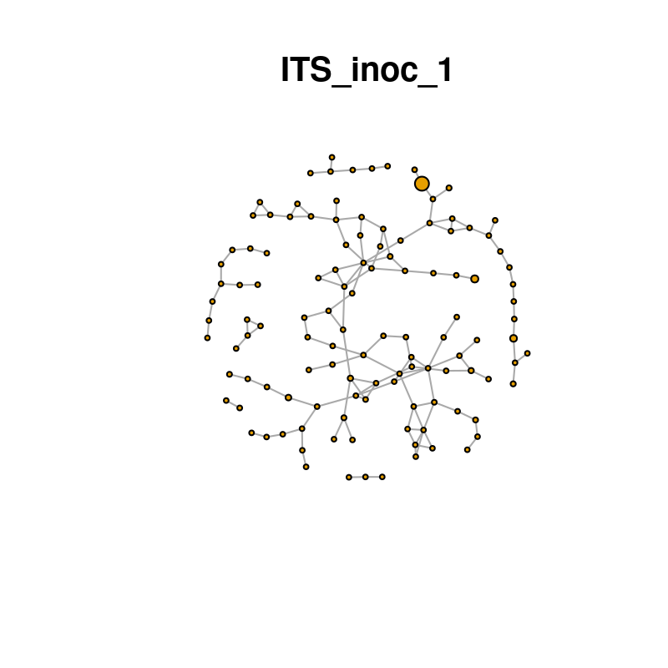
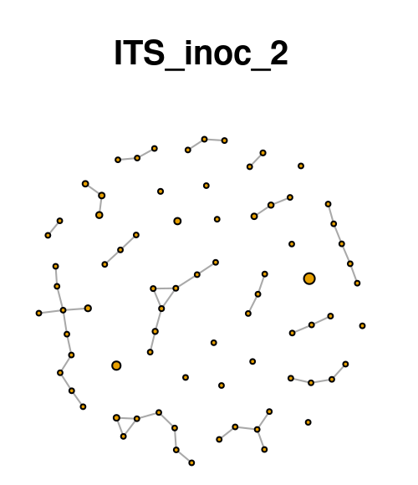
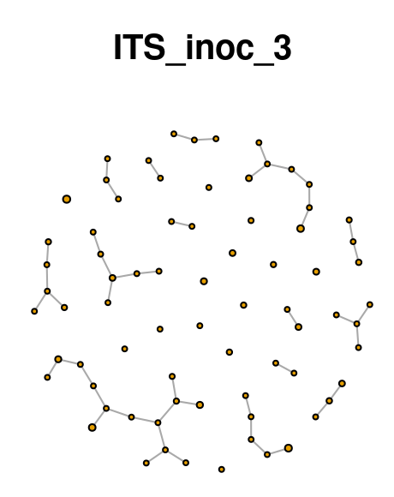
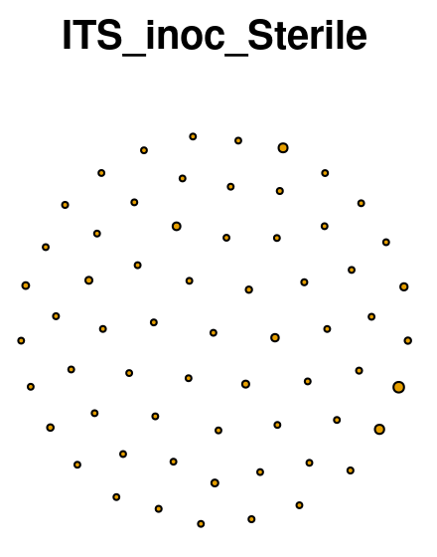
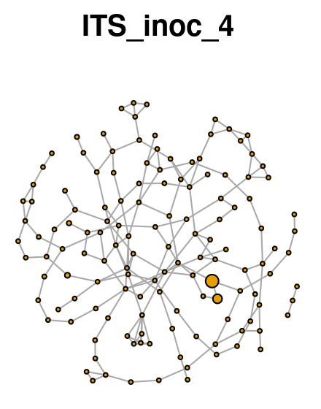
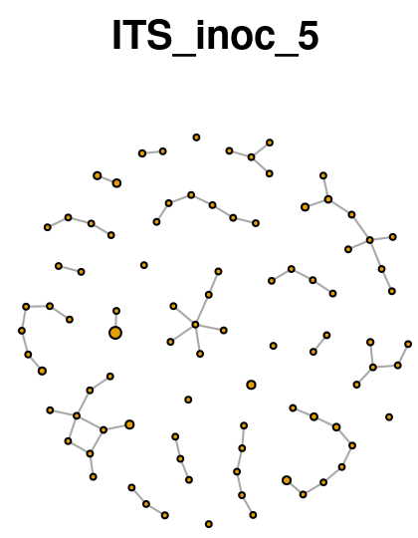
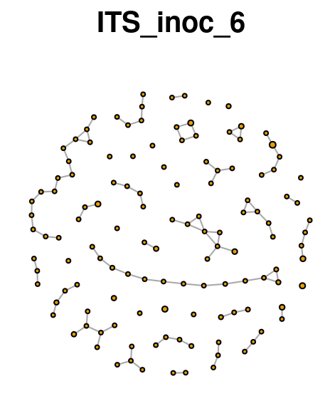

Slide 9
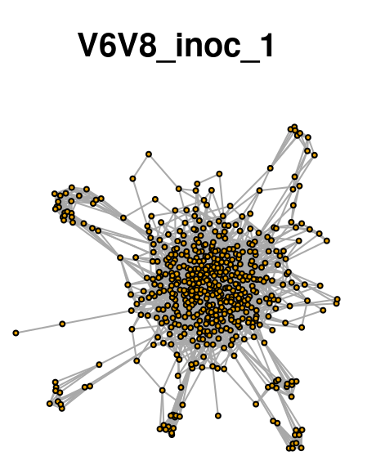
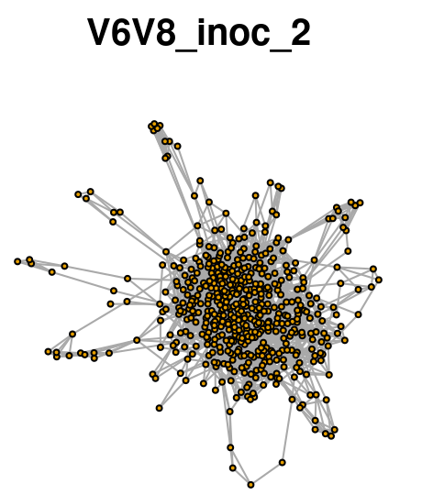
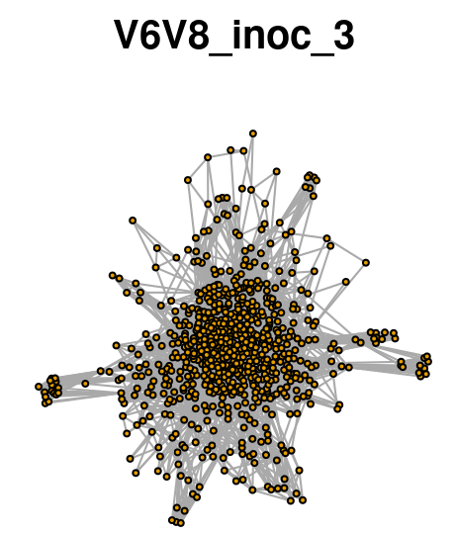
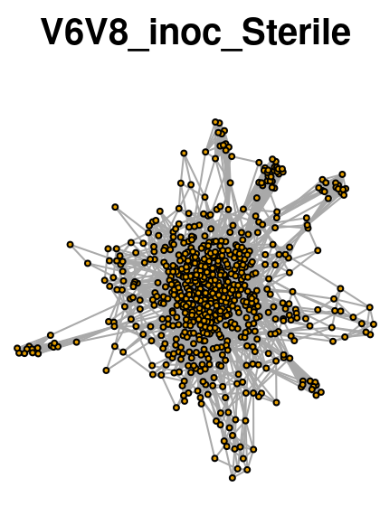
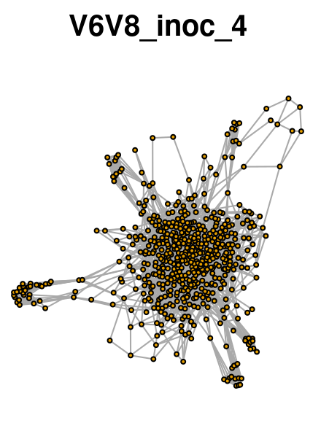
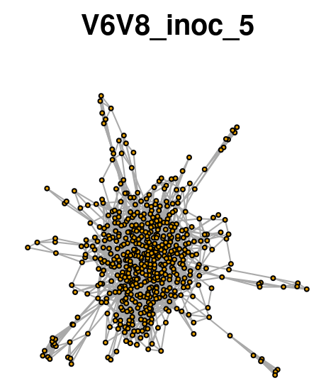
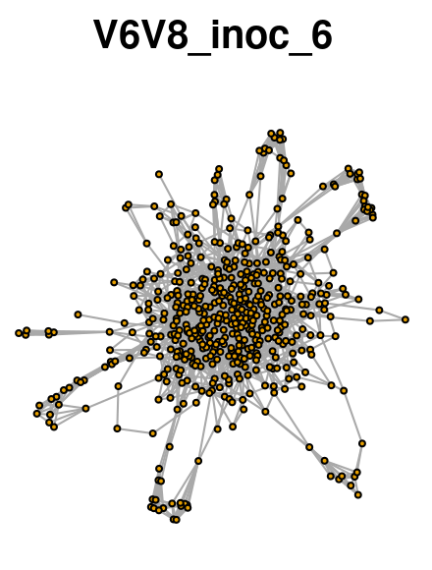

Slide 10
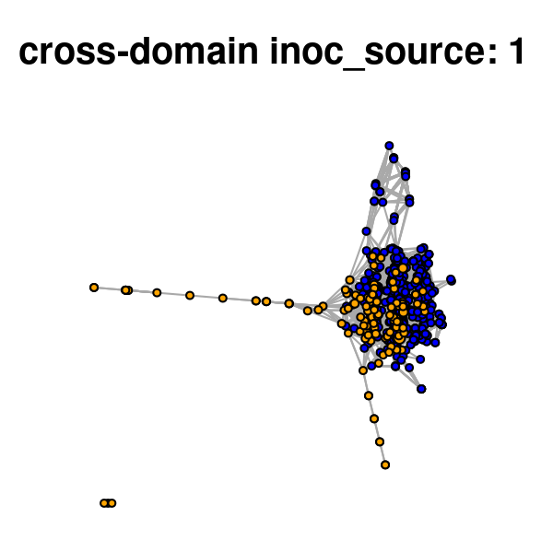
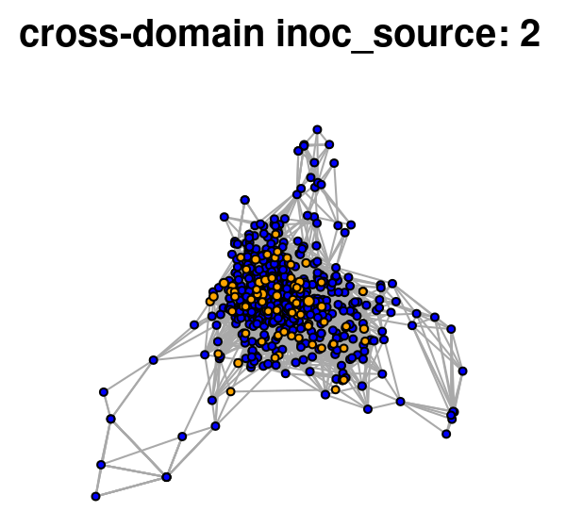
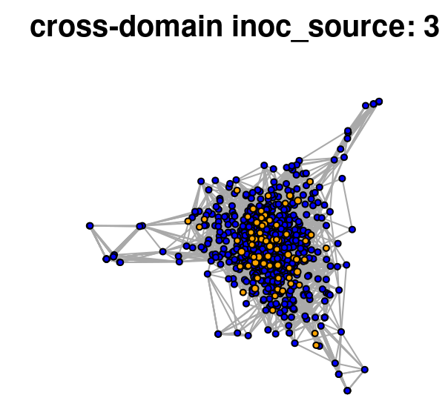
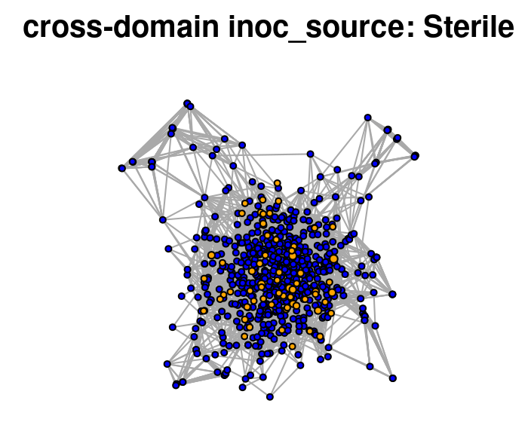
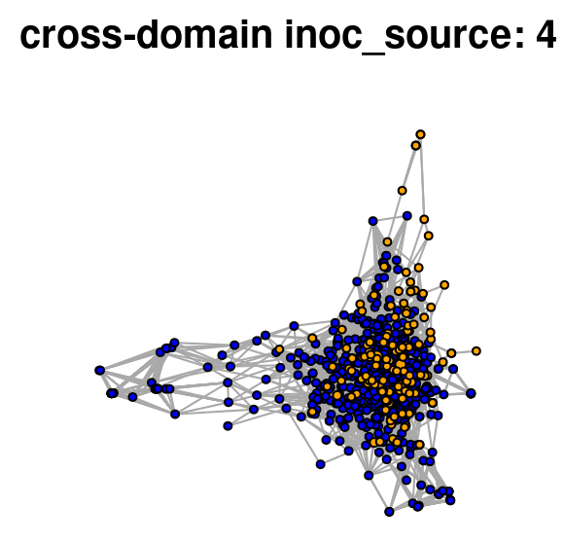
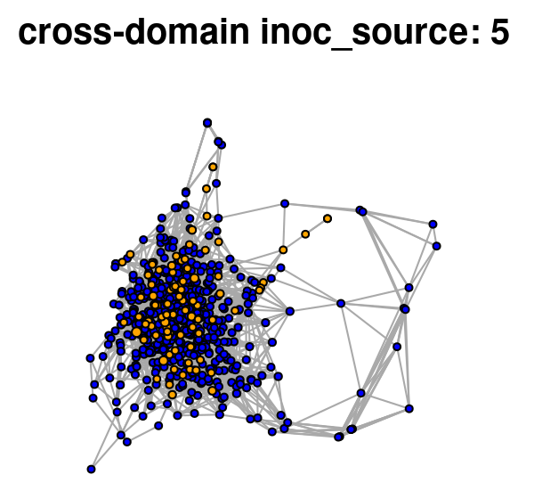
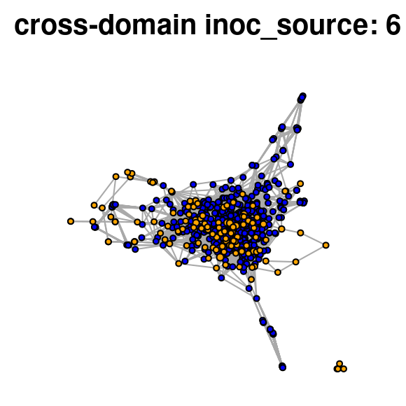
Blue = Bacterial nodes; Orange = Fungal nodes

Slide 11
Seedling performance
(Focal species: Doug fir)
Host specificity (with certain microbes)
Response to bioaugmentation
Growth benefit from priority effects
Microbiome
Total abundance, diversity
Guild abundance (mutualists, saprotrophs, pathogens)
Functional attributes/diversity
Traits (e.g., stress tolerance, host specificity, generalist vs specialist, R vs K strategists)
Network connectivity (hub taxa)
Enzyme activity (extracellular enzyme assays)
Biomass (e.g., ergosterol, PLFA, hyphal floating, hyphal ingrowth bags)
F:B ratio (PLFA, qPCR)
Environment
OM
pH
Nutrient availability (esp. N)
Moisture availability
Soil texture
Vegetation (neighboring plant species)
Source of microbes
Competition for resources, space
Light (shade vs open canopy)
Seedling growth
C to symbionts
Temperature

